Slide 1
QUICK INSTRUCTIONS ABOUT USING APPLICATION MICROSOFT TEAMS

Slide 2
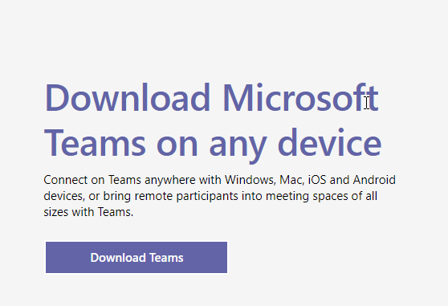
In your browser enter the following address: https://teams.microsoft.com/downloads and after clicking „Download Teams” download application on your PC, MAC, tablet or phone.

Slide 3
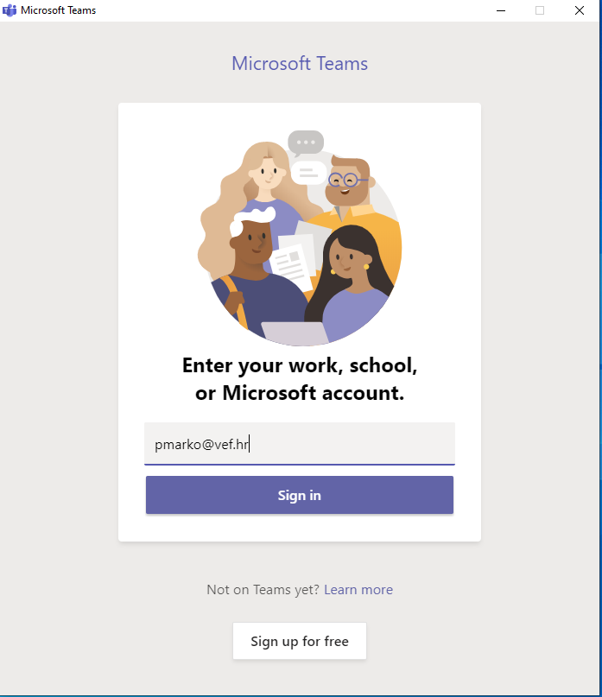
After successful instalation the application will start automatically and you will have to enter your AAI username.
IMPORTANT: users that made their Office365 account prior Faculty activation will have to use username in a following form: username@vefhr.onmicrosoft.com

Slide 4
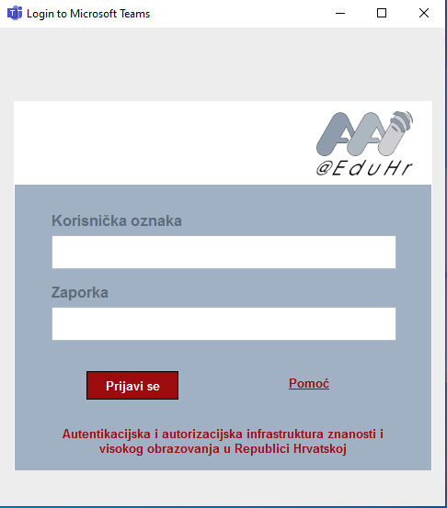
If you are logging in using AAI electronic identity you will be prompted to enter your credentials once again, for instance pmarko@vef.hr.
If you used username in the following form username@vefhr.onmicrosoft.com you will be prompted to enter your password so you can login into MS Teams

Slide 5
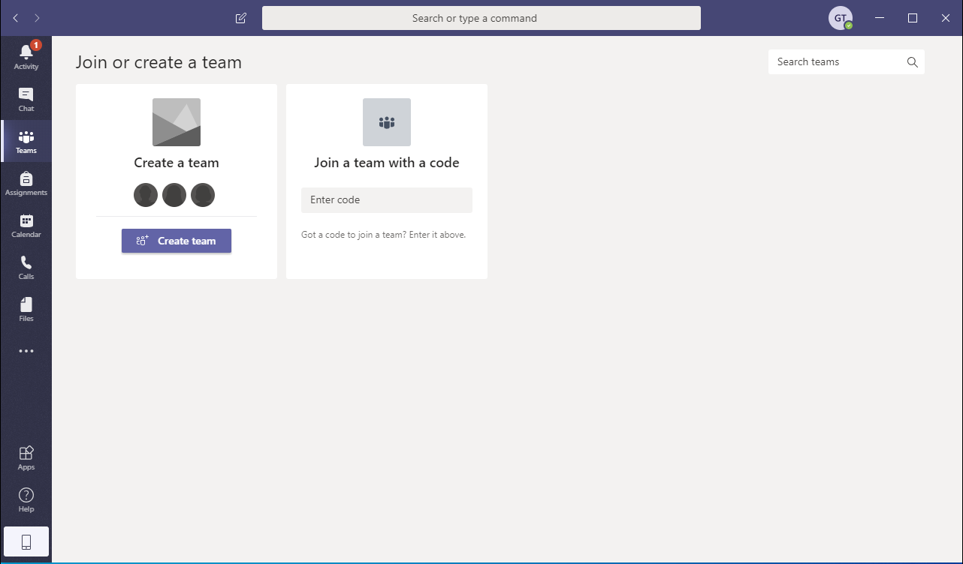
IMPORTANT
After successful login into MS Teams interface where your „Teams” (virtual classrooms) will be, your initial screen will look like one on the picture below and you will have to enter a code for a certain Subject using „Join a team with a code” in order to be added to it.

Slide 6
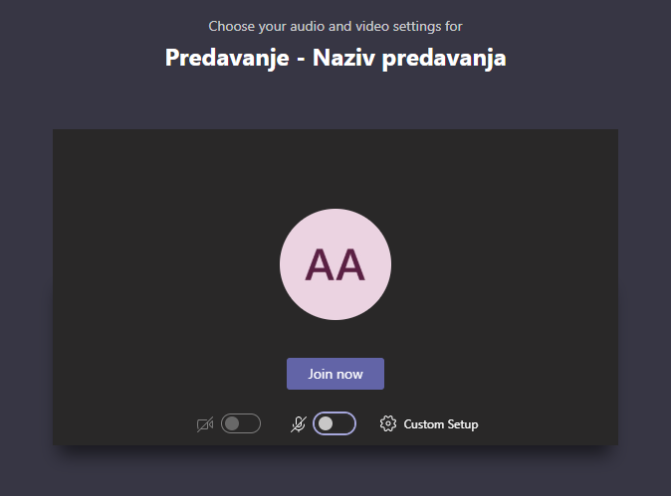
After you’ve picked up a Team (virtual lecture room) you will be able to connect into online lecture after teacher has started it by pressing a button „Join”.
IMPORTANT: PRIOR JOINING AN ONLINE LECTURE TURN OFF YOUR MIC AND YOUR CAMERA (either on PC, MAC, tablet or phone) SO YOU DO NOT DISTURB TEACHER WHILE HOLDING A LECTURE!

Slide 7
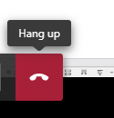
IMPORTANT
After teacher has ended the meeting (lecture) and left, PLEASE sign off too using hang up button.

Slide 8
Thank you for your attention
Marko Poletto, DVM

