Slide 1
GUIDELIENS AND INSTRUCTIONS HOW TO USE APPLICATION MICROSOFT TEAMS

Slide 2
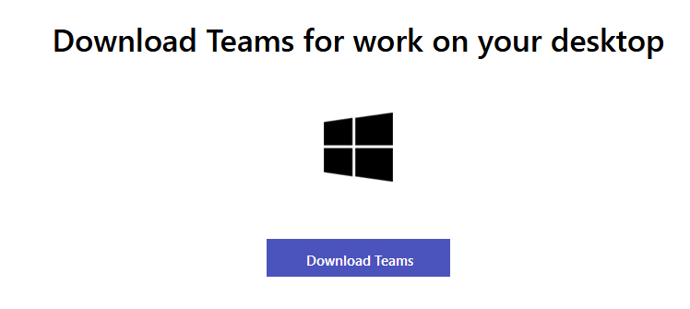
To install application MS Teams open your browser and enter following address: https://teams.microsoft.com/downloads then download it using button „Download for Desktop”
You will be forwarded to a page as shown below and will click again – „Download Teams”

Slide 3
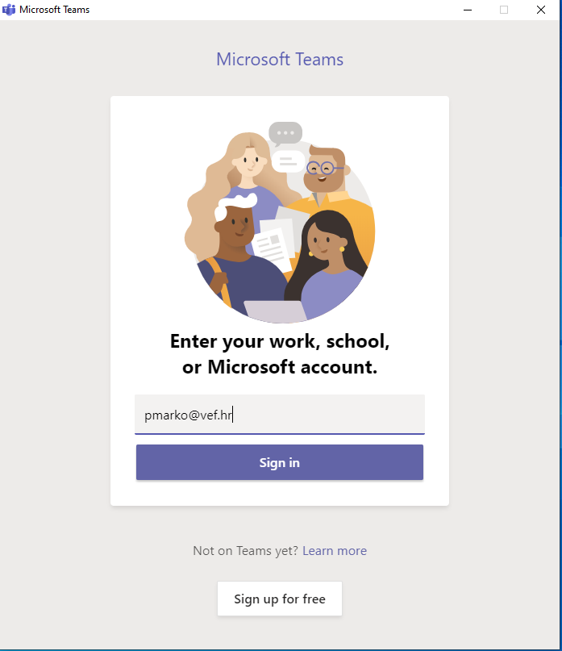
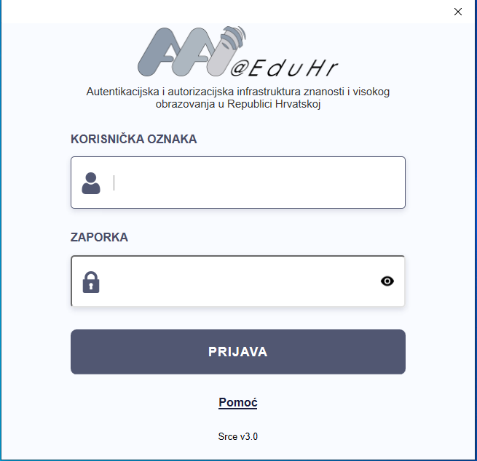
After successful instalation application will auto-start and you have to enter your – AAI electronic identity to be able to log into the system.
AAI identity (user name and password THAT YOU HAD TO CHANGE IMMEDIATELY) students of the first academic year got during first week of classes and they use those credentials to log onto STUDOMAT application and LMS system.
Higher academic years use their AAI electronic identity in same manner as they have so far. EXCEPTION are students that had to use username in a form of username@vefhr.onmicrosoft.com and they will use same credentials as they have before!
After you’ve used proper credentials click on the „Sign in” button to log in, using your AAI electronic identity (DOES NOT APPLY FOR THOSE STUDENTS THAT USE FORM IN A WAY username@vefhr.onmicrosoft.com).

Slide 4
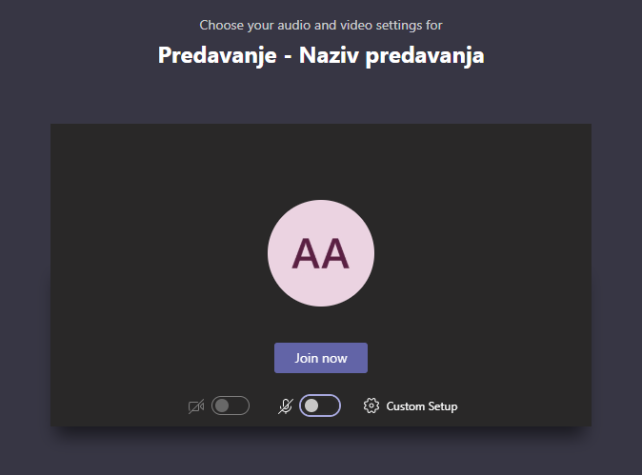
VERY IMPORTANT
After selecting appropriate „Team” (virtual classroom) you will be able to join in online lecture by pressing the button „Join” (shown when a teachers starts the lecture).
DO NOT START MEETINGS (LECTURES) ON YOUR OWN!
IMPORTANT: WHEN YOU ARE ABOUT TO JOIN A MEETING (LECTURE) EITHER USING YOUR PC OR PHONE IT’S IMPERATIVE TO TURN OFF YOUR CAMERA AND YOUR MICROFONE SO YOU DO NOT DISTURB TEACHER AND CLASS!

Slide 5
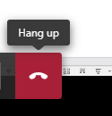
VERY IMPORTANT
Once the class is over (meaning there are no more questions and teacher have said goodbye to you and left the meeting) you should log out of the meeting in a 5 minute timeframe by pressing the button LEAVE/HANG UP!

Slide 6
Thank you for your attention
Material prepared by Marko Poletto, DVM
IT Department

