Slide 1
Please choose topics

Slide 2
Choose this highlighted topic

Slide 3
Choose this highlighted subtopic

Slide 4
Choose region Zagreb

Slide 5
Write the
Reason for obtaining
OIB
Attach files (in any)

Slide 6
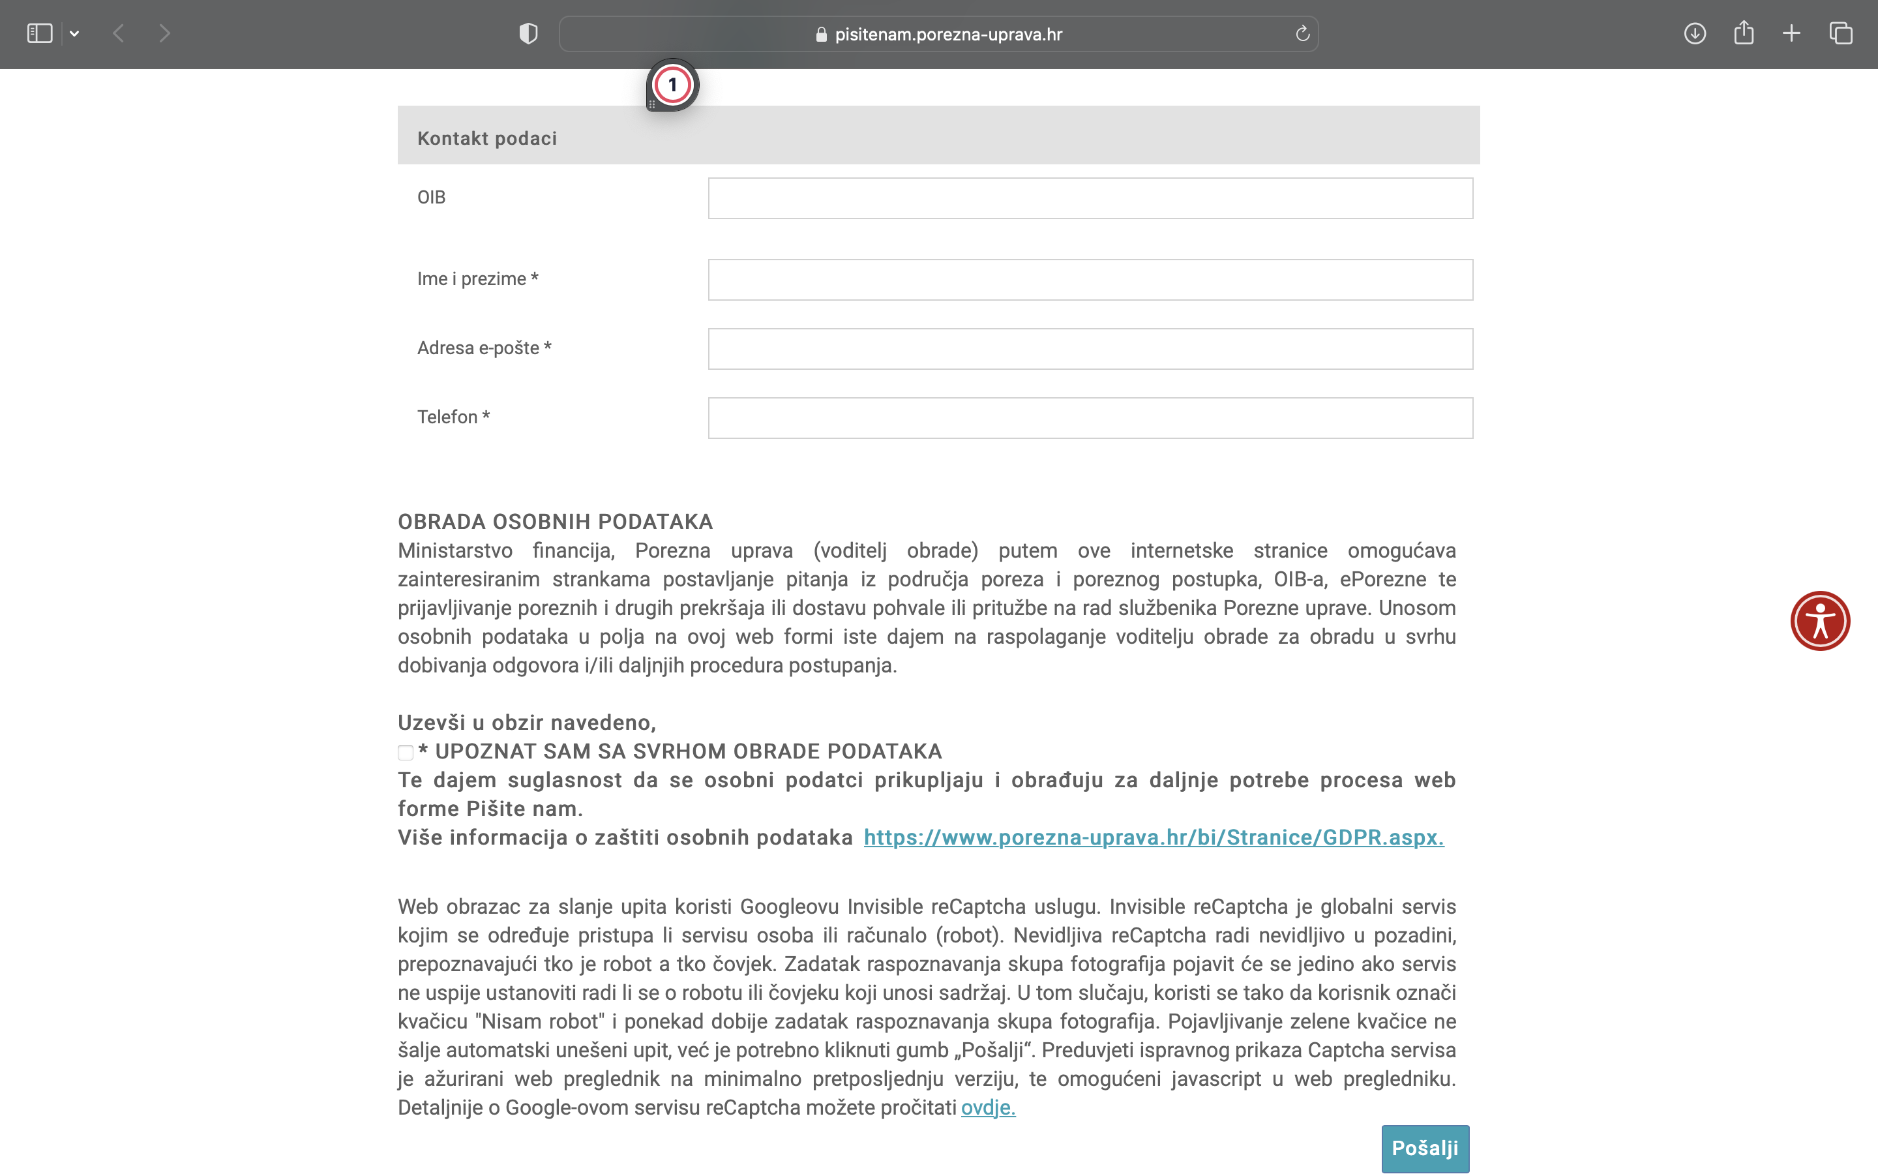
This line in not neccesary
Write your data
Name and Surname
E-mail
Phone number

Slide 7
Important links:
Request for OIB
https://www.porezna-uprava.hr/en/EN_obrasci/Documents/PINrequest.pdf
Document needed for aquiring OIB
https://www.porezna-uprava.hr/HR_OIB/Documents/oib%20dokumentacija%20-en%20(2).pdf
https://www.porezna-uprava.hr/en/Pages/SingleNews.aspx?NewsID=7&List=News

